Slide 1
SMART FIRE SUPRESSION SYSTEM
V Raj Narayanan
23BEC7234

Slide 2
CONTENT
Serial Number | Content | Slide Number
1 | Introduction | 3
2 | Circuit | 4
3 | Workflow | 5
4 | Hardware Components | 6
5 | Outcome | 10
6 | Conclusion | 11

Slide 3
introduction
Fire incidences continue to be one of the most prevalent and perilous disasters in both domestic and industrial settings, causing considerable damage to property and endangering human lives.
In several cases, the delay in detecting and acting on fire occurrences can exacerbate the effects of the disaster. In such instances, a fire detection and suppression system would be indispensable.
The current project proposes an intelligent flame suppression system that employs an ARDUINO UNO, ESP32 microcontroller, capable of detecting any fire occurrence and reacting accordingly without requiring any human input. The flame sensor senses any fire occurrence, and servo motors assist in pointing the water spray system towards the source of the flame.

Slide 4
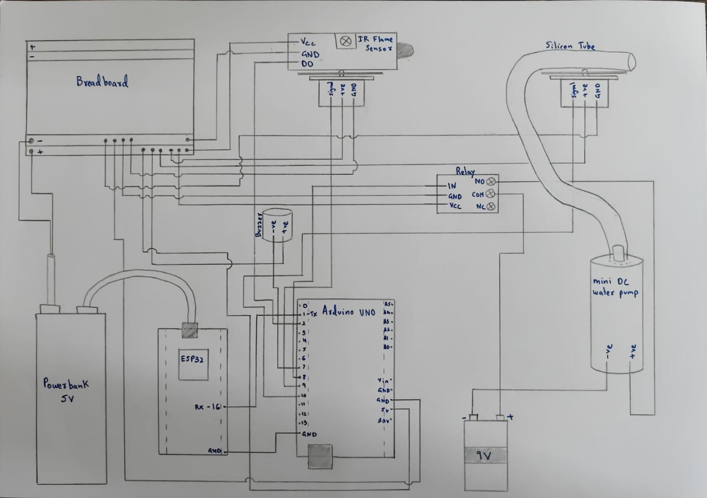
CIRCUIT

Slide 5
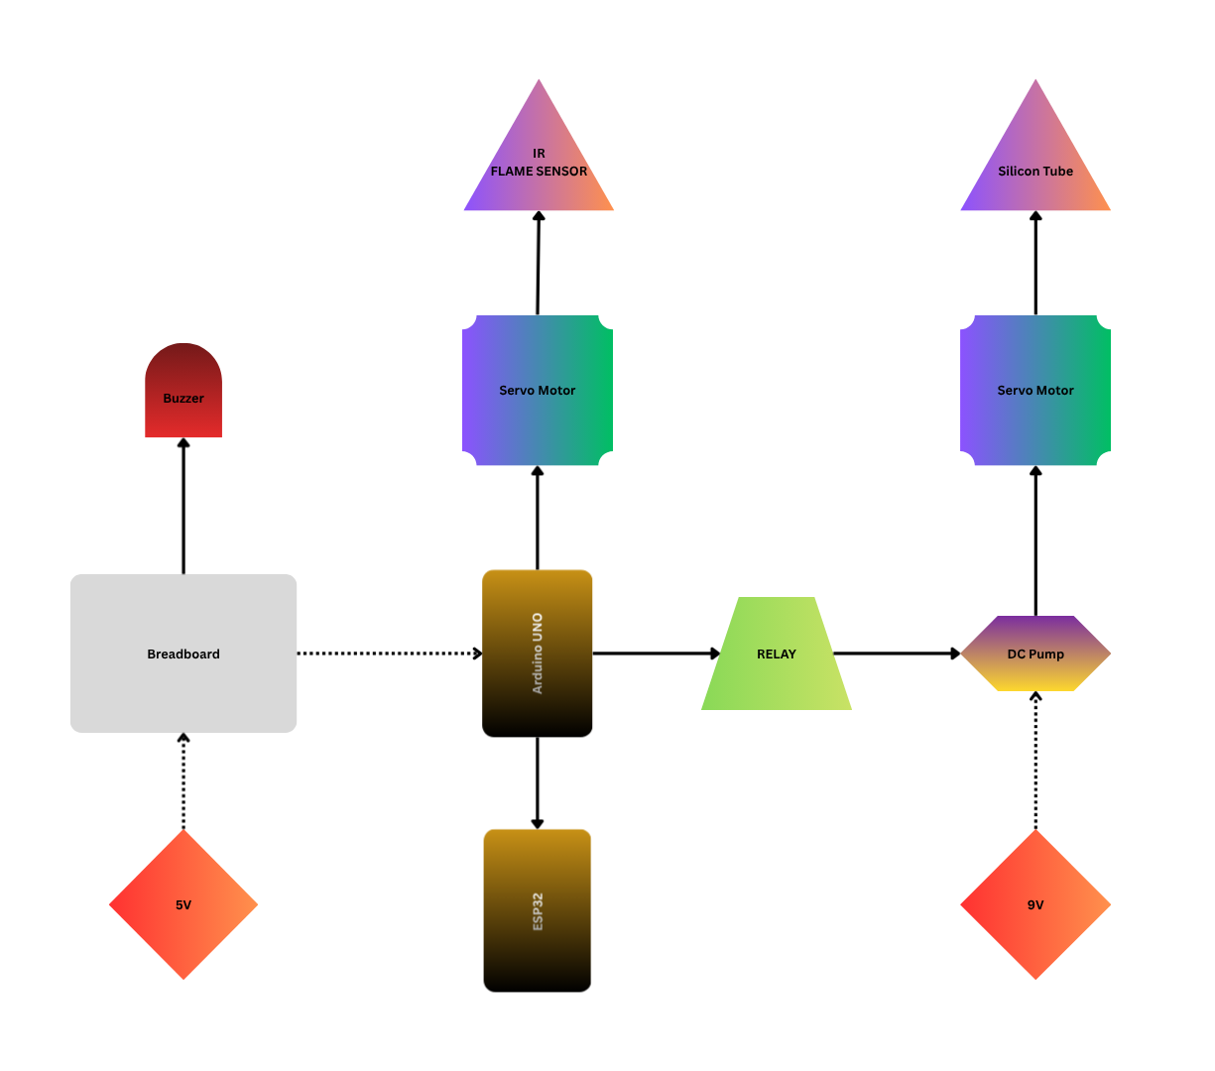
WORKFLOW

Slide 6
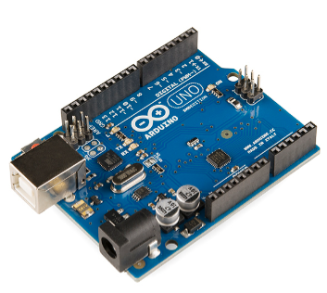
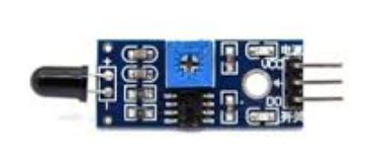
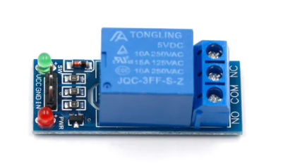
HARDWARE COMPONENTS
Arduino UNO
  Uses Arduino UNO as the main component in this project.
  Has 14 digital I/O pins, 6 PWM output, 6 analog input pins.
  Has in built wifi and Bluetooth modules.
IR FLAME SENSOR
  Used to detect flame at a max distance
  of 100cm using Infrared Receiver Ignition Source Module.
  It has a detect angle of 60 degrees and is very sensitive.
  It has a built in potentiometer to adjust sensitivity.
RELAY MODULE
  Used as an electrical switch to control the flow of power to the
  mini dc water pump.
  The switching is controlled using NO and NC channels.

Slide 7
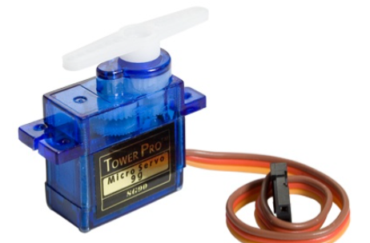
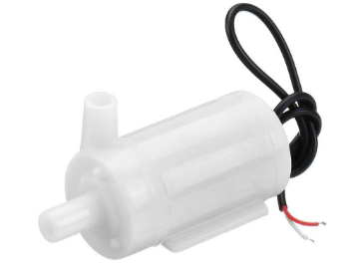
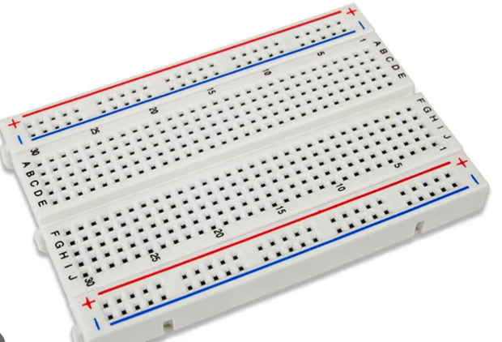
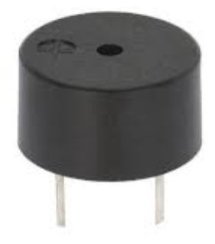
SERVO MOTORS
  Using 2 servo motors.
  1 to control the movement of Flame sensor, other for the silicon tube
    attached to the mini DC water pump.
MINI DC WATER PUMP
  Low cost submersible wate pump operated ~3-6V.
  Can take upto 120 liters per hour.
BREADBOARD
  Used to connect ground and Vcc for all the components.
Buzzer
  Will activate when a fire is detected.

Slide 8
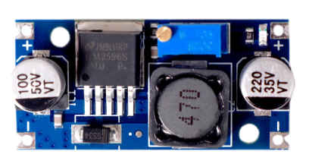
Buck Converter
  Used to step down from a higher input voltage to a
    specified lower voltage.
  Inbuilt potentiometer to control voltage level.
  Works on the principle of switching regulations using inductors.
Power supply
  Using 9v battery to power relay and pump
  Using 5V power bank to power Arduino UNO, servos, sensor
ESP32 DEV BOARD
  Used as a wifi module to transfer the data received from Arduino UNO to website

Slide 9
SERIAL NUMBER | COMPONENTS | OPERATING VOLTAGE | PRICE
1 | Arduino UNO R3 Development Board | 5V to 7V | Rs 350-450
2 | IR Infrared Flame Detector Sensor Module | 3.3V to 5V | Rs 100-200
3 | 1 Channel Relay Module | 5V | Rs 20-50
4 | Servo Motor | 4.6V to 6V | Rs 100-150
5 | Submersible Mini Water Pump DC Motor | 3V to 6V | Rs 50-100
6 | Breadboard | <36V | Rs 50-150
7 | Buzzer | 2.5V to 7V | Rs 20-50
8 | Buck Converter(Step Down) | 4V to 24V | Rs 100-200
9 | Battery Holder | ~ | Rs 100-150
10 | ESP32 Dev Board | 3.3V to 5.5V | Rs 150-250

Slide 10
OUTPUT
  This designed intelligent flame suppression system is capable of sensing the existence of flames with the help of an infrared flame sensor and operates automatically without any human interference.
  After sensing, the scanner servo recognizes the location of the flame, and the nozzle servo points the water jet towards that direction. At the same time, the relay actuates the water pump to spray water from the silicone hose, while the buzzer acts as a sound indicator to show fire sensing.
  The design shows a reliable performance with proper coordination among sensors and actuators, thereby imitating an automated fire extinguishing system.
  Therefore, the project fulfills its goal of designing a cost-effective and efficient fire suppression system.

Slide 11
conclusion
  I have successfully developed a working prototype of the Smart Flame Suppression System and is working as intended fulfilling all requirements.
  DIFFICULTIES:
    Stable and safe power supply to all components was a big issue.
    Powering the entire project by using a single battery holder with 7.4V output was not possible as while the dc water pump starts, it reduces the current which is needed to properly run the servos.
    This was solved by using 2 power supplies; a powerbank 5V input powering servos and esp and the buzzer and a 7.4V double LiPo battery holder which powers the relay and mini DC water pump.

Slide 12
references
Arduino UNO - https://robocraze.com/products/uno-smd-board-compatible-with-arduino?variant=40192903741593&country=IN&currency=INR
IR Flame Sensor - https://www.amazon.in/Electrobot-Detector-Voltage-Comparator-Detecting/dp/B08R3VH8H9
Single Channel Relay - https://handsontec.com/dataspecs/relay/1Ch-relay.pdf
Servo Motor - https://robu.in/product/towerpro-sg90-9gm-1-2kg-180-degree-rotation-servo-motor-good-quality/
Mini DC water pump - https://www.amazon.in/Electron-Submersible-Project-Fountain-Garden/dp/B0CVYT9C6C?source=ps-sl-shoppingads-lpcontext&ref_=fplfs&psc=1&smid=A3C7Z4RVM9A3G1
Buck Converter - https://robu.in/product/lm2596s-dc-dc-buck-converter-power-supply/

